Slide 1

Gulf Coast Area Rainfall Prediction
Jimmy Smart

Slide 2
Project Outline
Introduction
Data Wrangling
Dropping redundant variables
Identify feature values
Data Visualization
Rainfall
Temperatures
Summary
Statistical Analysis
Frequentism
Bootstrapping
Model Optimization
FB Prophet
Linear Regression
XGBoost
Random Forest
Comparing models
Conclusion

Slide 3
Introduction
Dataset contains historical weather data of five cities along the Gulf Coast shores.
Our data is from https://ww.ncdc.noaa.gov/
The original datasets for all 5 cities New_Orleans.csv, Houston.csv, Pascagoula.csv, Mobile.csv and Tampa.csv were loaded in and saved as 1 dataset into a Jupyter Notebook.
The goal of this project is to use the features, from the datasets listed above, to predict daily rainfall amounts based on past rainfall
Q:
Can we predict rainfall for the Gulf Coast Area?

Slide 4

Data
Wrangling

Slide 5
Featured values from dataset
Our 5 datasets were given a quick cleaning within their original Excel format before being saved as CSV files and read into our notebook as one through glob. Concat was used to create one dataframe.
Featured values:
df = df[[ 'STATION', 'datetime', 'REPORT_TYPE', 'DailyDewPoint', 'DailyRelativeHumidity', 'DeailySeaLevelPressure', 'DailyAverageDewPointTemperature', 'DailyAverageRelativeHumidity', 'DailyAverageSeaLevelPressure', 'DailyMaximumDryBulbTemperature', 'DailyMinimumDryBulbTemperature', 'DailyAverageDryBulbTemperature', 'DailyPeakWindSpeed', 'DailyPrecipitation' ]]

Slide 6
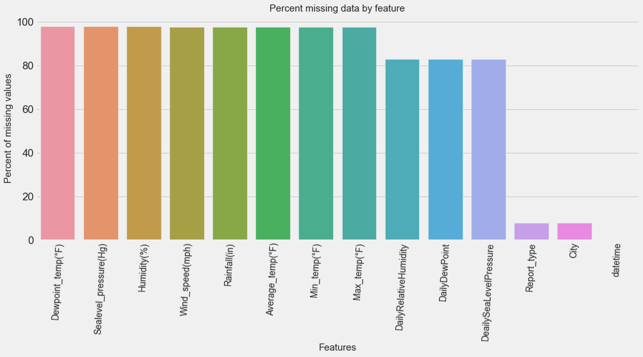
Identifying missing data
Our featured values had a large percentage of null values due to the structure of the dataset having hourly, daily, monthly data.
Focus only on the daily data figures by using .loc to pull out rows that only consisted of daily data.

Slide 7
 | null_sum | null_pct | dtypes | count | mean | median | std | min | max
Average_temp | 0 | 0.0 | float64 | 18243 | 70.944581 | 74.000000 | 12.746689 | 26 | 95
City | 0 | 0.0 | object | 18243 | NaN | NaN | NaN | Houston | Tampa
Dewpoint | 0 | 0.0 | float64 | 18243 | 60.499926 | 64.500000 | 13.934829 | 4.70833 | 80
Humidity | 0 | 0.0 | float64 | 18243 | 73.628929 | 75.000000 | 11.397478 | 21 | 100
Max_temp | 0 | 0.0 | float64 | 18243 | 79.980266 | 82.000000 | 12.198700 | 31 | 109
Min_temp | 0 | 0.0 | float64 | 18243 | 61.407170 | 65.000000 | 14.031359 | 16 | 85
Rainfall(in) | 0 | 0.0 | object | 18243 | 0.159897 | 0.000000 | 0.523273 | 0 | 16.07
Sealevel_press | 0 | 0.0 | float64 | 18243 | 30.049150 | 30.035833 | 0.140398 | 29.44 | 30.6954
Wind_speed | 0 | 0.0 | object | 18243 | 23.381571 | 22.000000 | 37.303786 | 0 | 2237
datetime | 0 | 0.0 | datetime64 | 18243 | NaN | NaN | NaN | 2010-01-01 | 2019-12-31
EDA Analysis

Slide 8
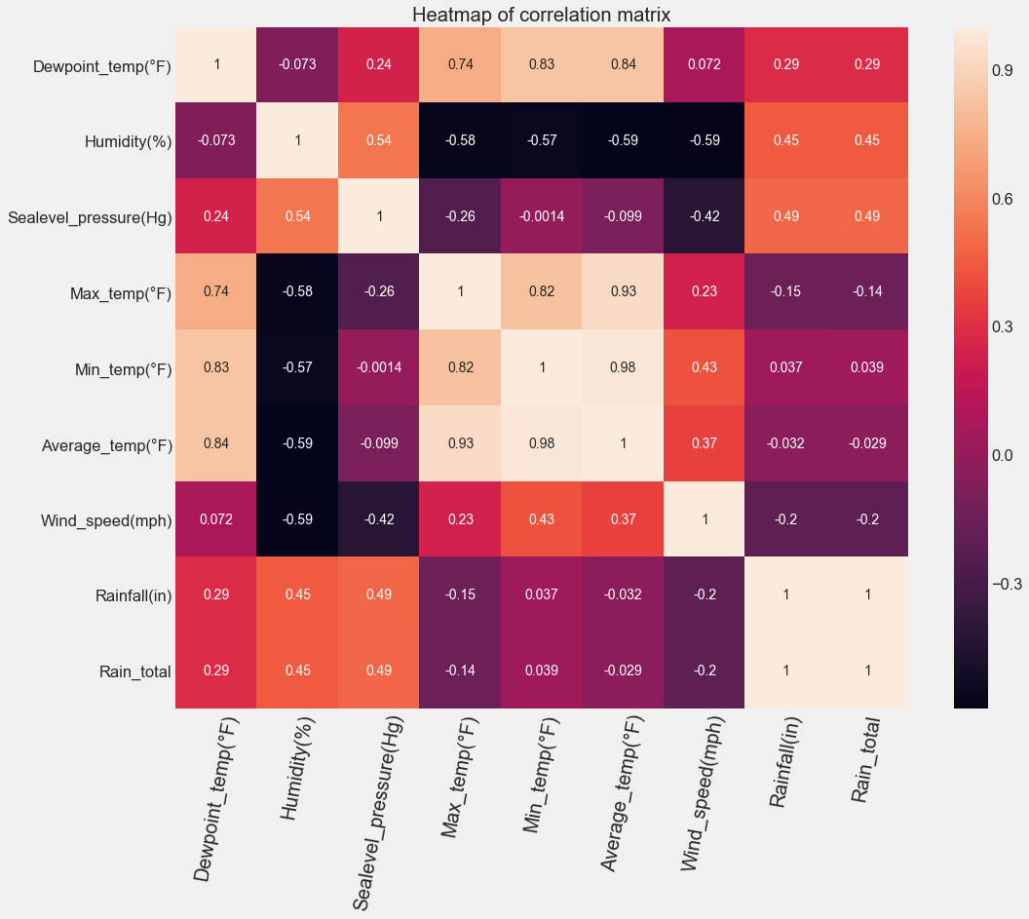
Data Visualization
From this heatmap we can see that Dewpoint and our max, min, average daily temperatures have a positive correlation.
While Humidity has a negative correlation with our temperature variables.
Rainfall has decent correlations with Humidity(0.31) and Sealevel Pressure (0.49) which makes sense because as a storm rolls in humidity usually rises as does sealevel pressures.

Slide 9
Rainfall
City | Dewpoint(°F) | Humidity(%) | Sealevel_pressure(Hg) | Max_temp(°F) | Min_temp(°F) | Avg_temp(°F) | Wind_speed(mph) | Rainfall(in) | Rain_total
Houston | 59.784873 | 72.047958 | 30.021814 | 80.700192 | 60.899699 | 71.047136 | 24.181694 | 0.139984 | 510.80
Mobile | 59.931493 | 77.123816 | 30.064963 | 78.147244 | 59.645736 | 69.145873 | 22.132712 | 0.166597 | 607.58
New Orleans | 60.473006 | 71.836942 | 30.054149 | 79.387229 | 62.785969 | 71.346396 | 24.034804 | 0.174412 | 636.43
Pascagoula | 59.076459 | 76.829816 | 30.054634 | 78.810907 | 56.954782 | 68.133461 | 20.773089 | 0.169819 | 619.67
Tampa | 63.233489 | 70.308030 | 30.050197 | 82.854755 | 66.748698 | 75.049055 | 22.719649 | 0.148676 | 542.52
Yearly averages of our features separated by our 5 cities
Total rainfall amounts for the past decade

Slide 10
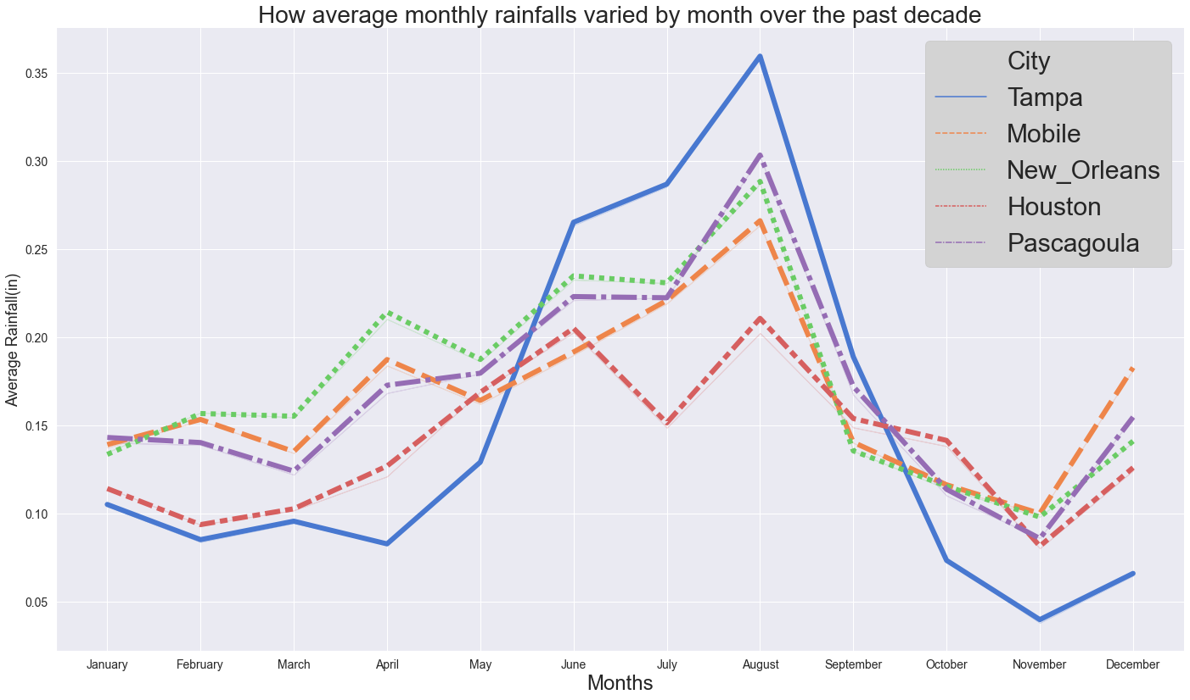
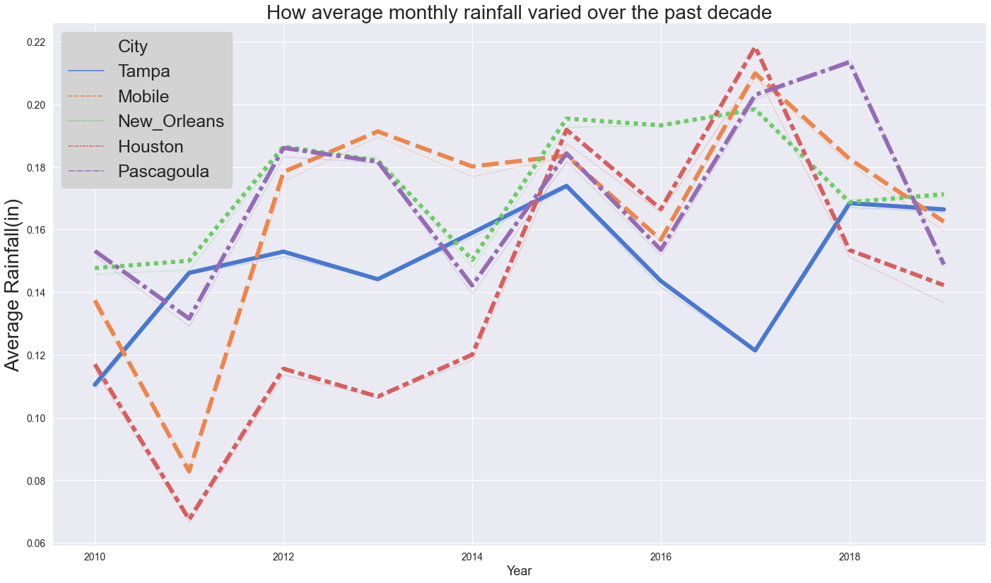
(left) Average monthly rainfalls varied by months for each of our cities. We can see that Tampa had the highest and lowest totals amongst our 5 cities.
(right) yearly averages for rainfall amongst our cities tells a little bit of a different story than the monthly averages.

Slide 11
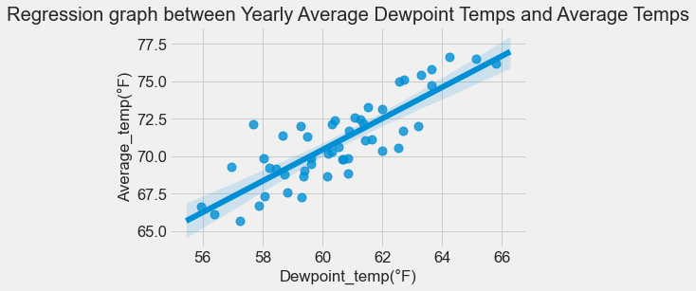
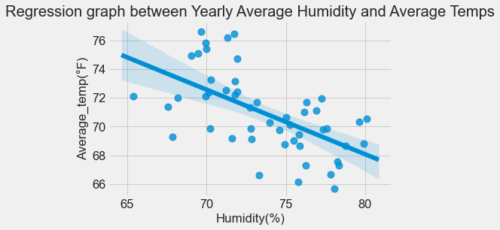
(top left) As our Dewpoint temperatures rose, so did our average temperatures. (top right) As our Humidity percentages rose our average temperatures decreased. (bottom center) As our rainfall increased so did our humidity percentages.

Slide 12
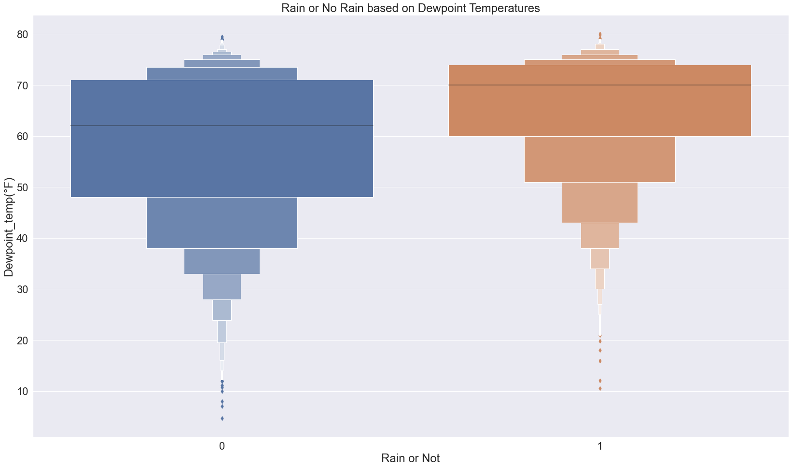
We created a new feature (Rain-1 or Not-0)
As we can see from the figure to the left, on days that we had rain, our average Dewpoint temperatures were higher than days without rain.
Our non rainy days also showed lower falling outliers than on rainy days

Slide 13
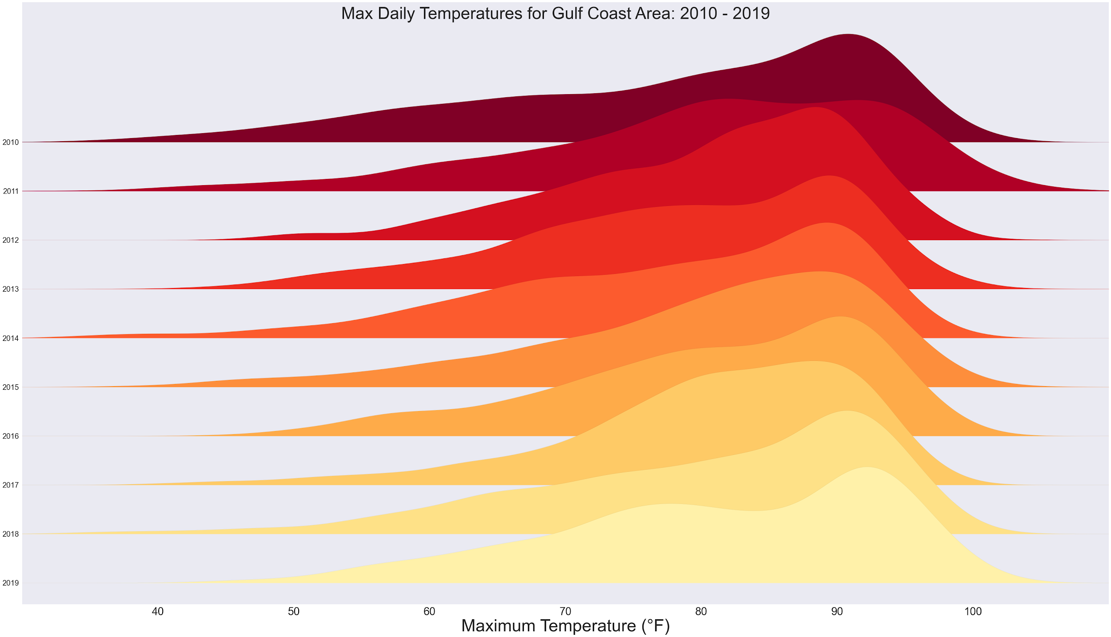
Max_temp(°F):
Year
2010 78.081644
2011 80.559648
2012 80.828415
2013 78.713029
2014 78.003297
2015 80.202192
2016 80.704372
2017 80.885479
2018 80.456438
2019 81.356164
Here we can see how our average temperatures have fared over the months of our dataset. Summer months are typically known to be hot in this area with a bit of a break from the heat in the other months of the year.

Slide 14
Data Visualization Summary
We were able to see weather trends that can be useful to any clients looking to see how weather has been and may be in the future.
Rainfall amounts fluctuate during parts of the season but look to be holding steady overall
When looking at temperatures over the past decade we were able to see that there has been an upward trend towards average temperatures rising each year.

Slide 15
Bootstrapping
Statistical Analysis
Bootstrap sampling to estimate a 95% confidence interval lower limit.
Null Hypothesis: Can we predict rain patterns for years to come based on past data from the Gulf Coast Area.
Alternate Hypothesis: We will not be able to predict future rain patterns based off of past weather data for the Gulf Coast Area.
Difference of STD for rainfall and non rainfall days: 0.834636440830481
Difference of STD for bootstrap samples: 0.8332447469738007
The 95% confidence interval for the difference between the standard deviations of rainfall and non rainfall day is: [0.76690786 & 0.90884574]

Slide 16
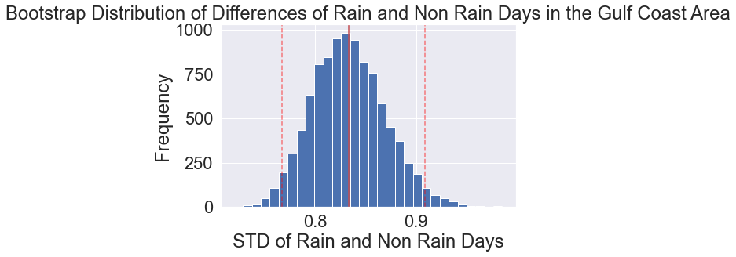
def diff_of_means(data_1, data_2):
diff = np.mean(data_1) - np.mean(data_2)
return diff
# Compute difference of mean rainfall and non rainfall: empirical_diff_means
empirical_diff_means = diff_of_means(rainfall, no_rainfall)
# Draw 10,000 permutation replicates: perm_replicates
perm_replicates = draw_perm_reps(rainfall, no_rainfall, diff_of_means, size=N_rep)
# Compute permutation p-value: perm_p
perm_p = np.sum(perm_replicates >= empirical_diff_means) / len(perm_replicates)
#Compute p-value: p
p = np.sum(bs_perm_rep >= diff_means)/len(bs_perm_rep)
Perm p-value = 0.0
P-value= 0.7383
Performed our test at 5% significance level to calculate p-value between rainfall days and non rainfall days
With a p-value of 0.7383, I can reject the alternate hypothesis and accept the null hypothesis

Slide 17
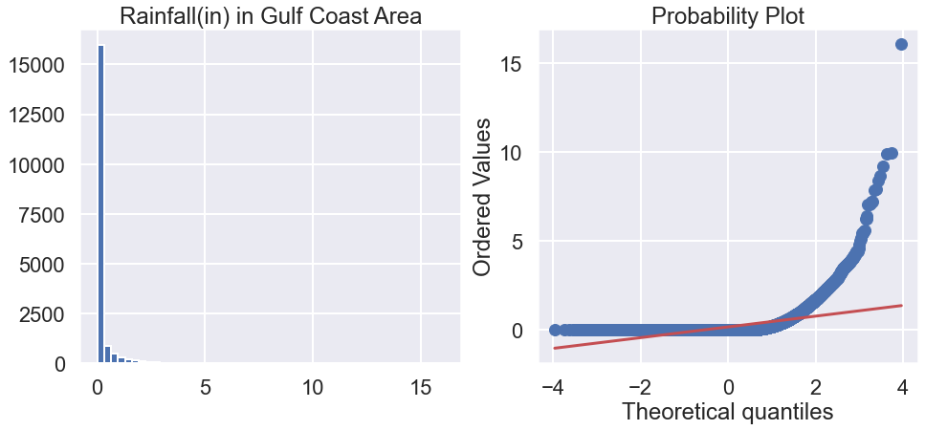
Normal dist. (mu = 0.10 and sigma = 0.26)
count mean std min 25% 50% 75% max
Rainfall(in) 18243.0 0.159897 0.5233 0.0 0.0 0.0 0.03 16.07

Slide 18

Model
Optimization
FB Prophet
Linear Regression
XGBoost
Random Forest
2 datasets:
without Rainfall outliers
with Rainfall outliers

Slide 19
Comparing Models
without outliers
Our r2 percentages fluctuate and showed an issue of overfitting with our Training set especially for XGBoost and RF
Testing r2 relatively showed 20-30% relationship between your testing model and our dependent variable (Rainfall)
MAE results are good as the values aren’t too high which means we weren’t “punished” too much for huge errors.
RMSE results are good too considering they stayed fairly low as well
name | R2 - Test | R2 - Train | MAE - Test | MAE - Train | RMSE - Test | RSME - Train
FB Prophet | -0.001 | NaN | 0.248 | NaN | 0.468 | NaN
Linear Regression(multiple) | 0.223 | -2.600 | 0.214 | 0.220 | 0.396 | 0.406
XGBoost | 0.255 | 0.650 | 0.161 | 0.220 | 0.373 | 0.217
Random Forest | 0.292 | 0.847 | 0.167 | 0.065 | 0.382 | 0.142

Slide 20
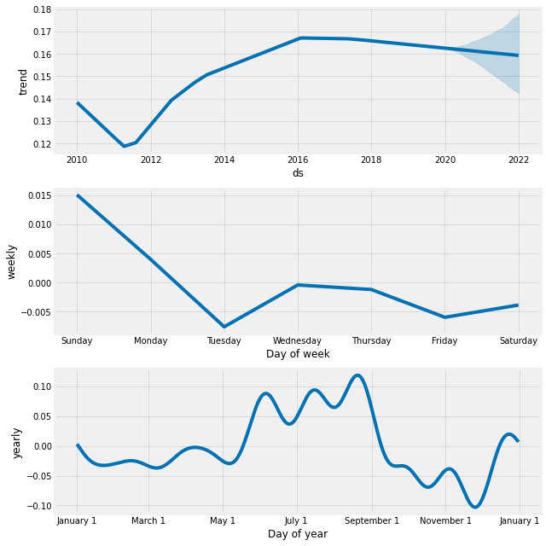
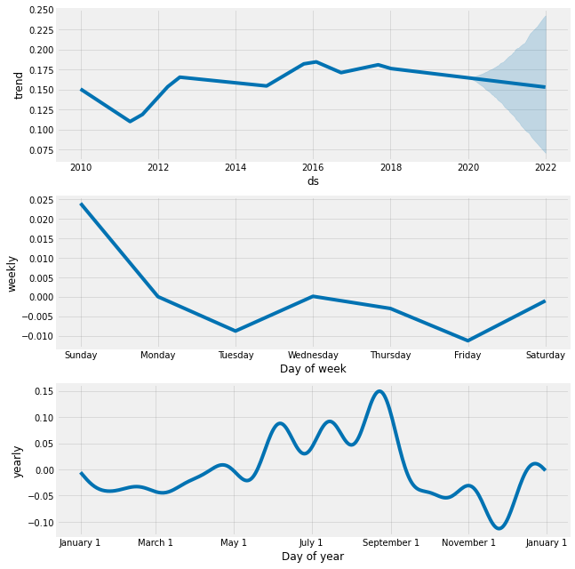
Model without outliers
Model with outliers
FB Prophet - trends

Slide 21
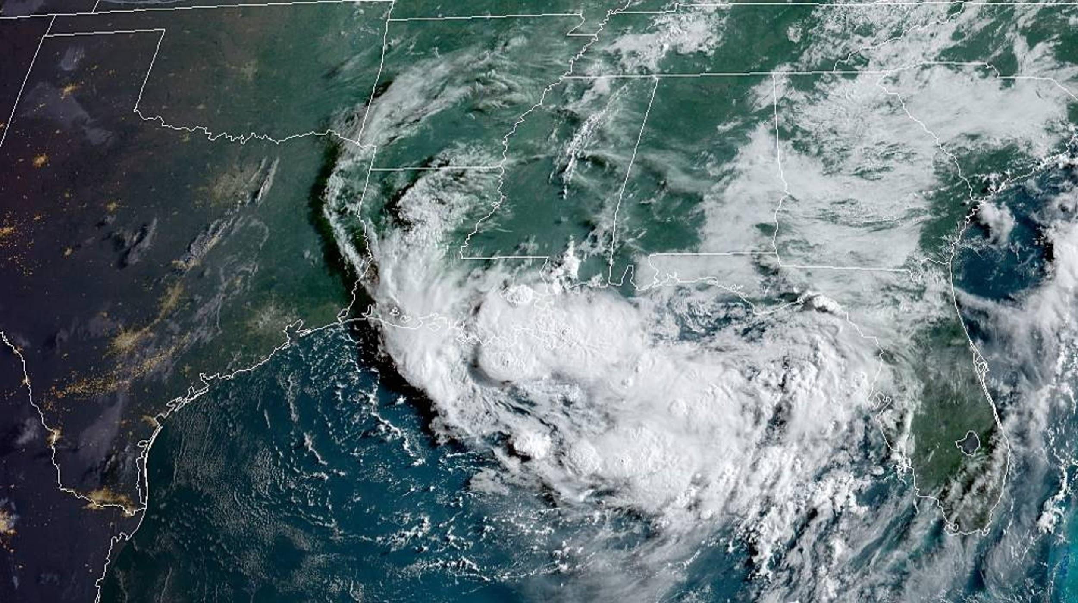
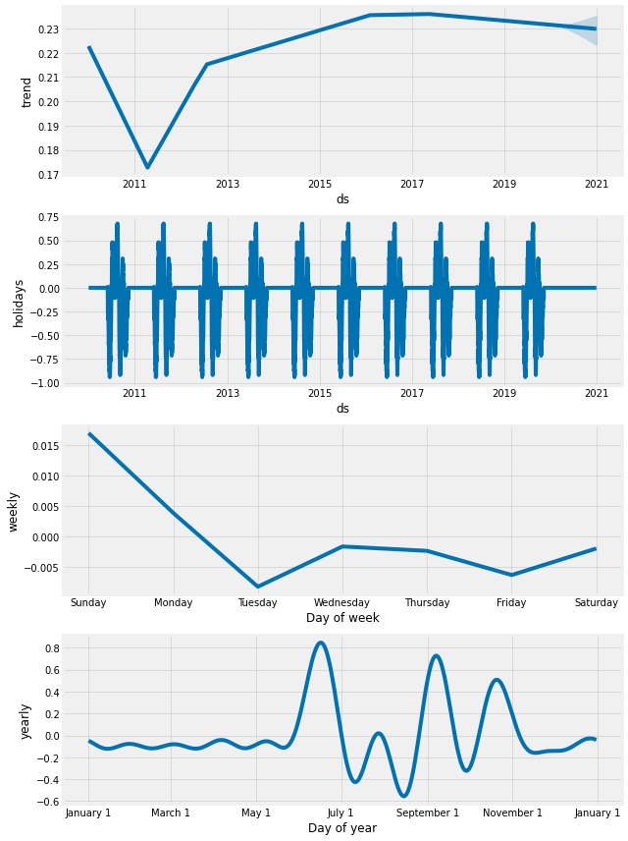
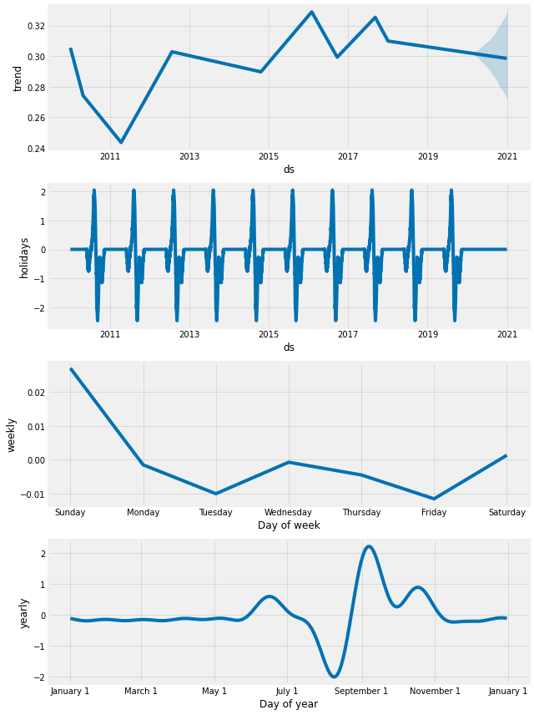
Hurricane Season
Model without outliers
Model with outliers

Slide 22
Importance Features
(without outliers)
Features | FB Prophet | LR (multiple) | XGBoost | Random Forest
Sealevel_pressure(Hg) | -0.194383 | -0.212812 | 0.104949 | 0.149999
Max_temp(°F) | 0.007984 | -0.002402 | 0.102125 | 0.096114
Average_temp(°F) | 0.064095 | 0.009596 | 0.102010 | 0.062910
Min_temp(°F) | 0.109440 | 0.007863 | 0.138275 | 0.088046
Dewpoint_temp(°F) | 0.159427 | -0.017660 | 0.071421 | 0.103797
Wind_speed(mph) | 0.326622 | 0.019038 | 0.241180 | 0.212961
Humidity(%) | 0.331100 | 0.018864 | 0.240040 | 0.286172

Slide 23
Importance Features
(with outliers)
Features | FB Prophet | LR (multiple) | XGBoost | Random Forest
Sealevel_pressure(Hg) | -0.194946 | -0.228957 | 0.106688 | 0.150871
Max_temp(°F) | 0.005526 | 0.006074 | 0.130203 | 0.098977
Average_temp(°F) | 0.060142 | -0.006568 | 0.135132 | 0.061892
Min_temp(°F) | 0.104485 | 0.017008 | 0.122700 | 0.099537
Dewpoint_temp(°F) | 0.150118 | -0.019476 | 0.096356 | 0.104089
Wind_speed(mph) | 0.311427 | 0.022094 | 0.192597 | 0.212199
Humidity(%) | 0.321254 | 0.020152 | 0.216324 | 0.272435

Slide 24
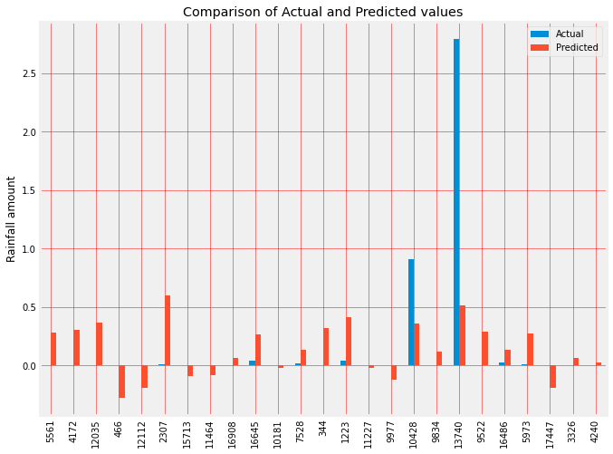
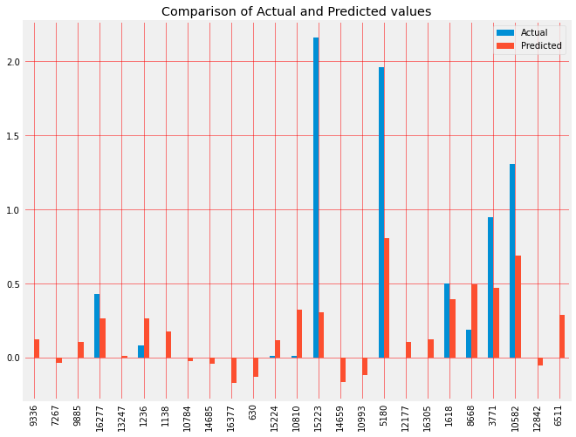
Linear Regression Prediction
Without outliers
With outliers

Slide 25
Comparing Models
with outliers
We didn’t see anything too drastic between our 2 sets of models
R2 scores stayed relatively near our models without outliers. XGBoost’s overfitting is still high but was able to come down some.
Again r2 relatively showed 20-30% relationship between your testing models and our dependent variable (Rainfall)
MAE results are good as the values aren’t too high which means we weren’t “punished” too much for huge errors.
RMSE results are good too considering they stayed fairly low as well
FB Prophet showed the worst r2 score amongst our models
name | R2 - Test | R2 - Train | MAE - Test | MAE - Train | RMSE - Test | RSME - Train
FB Prophet | -0.003 | NaN | 0.261 | NaN | 0.544 | NaN
Linear Regression (multiple) | 0.174 | -2.726 | 0.235 | 0.233 | 0.511 | 0.456
XGBoost | 0.346 | 0.277 | 0.167 | 0.233 | 0.409 | 0.318
Random Forest | 0.311 | 0.851 | 0.170 | 0.065 | 0.196 | 0.026

Slide 26
Conclusion
Results
Results:
Our models did not score as high as we would have liked in regards to r2 but we were able to see some benefits from them
We were able to find which features offered more importance
More hypertuning could help raise our r2 scores.
Next Steps:
Predicting weather can be tricky as we’ve seen. To build a better model we might need to look at historical weather data from other parts of the country and world.
The features we used didn’t have as big of an impact as we would have like. For future modeling we could bring in more features and find a better mixture of features that show more importance to our Rainfall variable

